Slide 1
Analyzing credit card defaults
Ijya Paudel
Github: @ijyaa

Slide 2
Content:
Introduction to the dataset
Why is it important?
What am I trying to answer?
Is there a correlation between social factors age / gender/ education / relationship status and default rates? Is one group more likely to default than others?
Does limit balance play a factor in default rates? Are customers with a lower balance more likely to default than customers with higher balances?
Can bill amount predict default rates? Does a high bill amount lead to higher default rates?
Further Analysis

Slide 3
Introduction:
Dataset is from University of California, Irvine’s Machine Learning Repository.
Dataset’s source is from I-Cheng Yeh from Chung Hua University in Taiwan
30,000 credit card customers in Taiwan
Aims to predict defaults in binary terms (default vs. non-default)
Each customer has various social demographics / financial factors:
Age
Gender (M / F)
Relationship Status
Education
Limit Balance
Payment History
Bills
Mean age of customers: 35 years old
Male customers: 11,888
Female customers: 18,112
# of Customers that default: 6,636
# of Customers that pay: 23,364

Slide 4
Why important?
Predicting / assessing likelihood of credit card default is valuable to lenders
This can serve as a risk mitigation tool for various lenders (banks, retailers, colleges/ universities etc)
Provides a way to predict default rates without having credit score report / previous credit history

Slide 5
My approach:
I only looked at these factors:
Age
Relationship status
Gender
Education
Limit Balances
Bills
I mostly used stats to analyze the dataset
I will refer to the monetary amount as dollars going forward (Taiwan uses New Taiwan Dollar - I did not convert to USD)

Slide 6
Is there a correlation between gender / default rates?
Female Stats:
# of Female Customers: 18,112 Mean age: 35 Mean Limit: 170,086 Standard Deviation of Limits: 125,231 Default Percentage: .2077 Standard Deviation of Default: 0.405
Male Stats:
# of Male Customers: 11,888 Mean age: 36 Mean Limit: 163,519 Standard Deviation of Limits: 136,250 Default Percentage: .2417 Standard Deviation of Default: 0.428

Slide 7
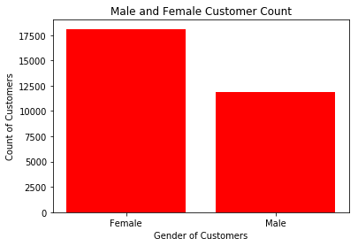
Graph of Female v. Male Customers
18,112
11,888
Notes:
Used a bar graph from matplotlib to create this graph

Slide 8
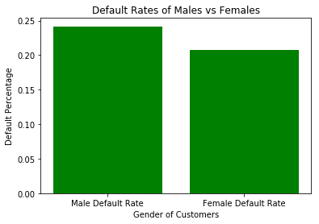
Graph of Default Rate between Male v. Female
24.17%
20.77%

Slide 9
Is the finding statistically relevant?
An independent samples T-Test was used to check if the findings were statistically relevant as proven by a p-value lower than 0.5.
This shows that male customers are more likely to default than female customers.

Slide 10
Is there a correlation between age/ default rates?
Age is more skewed to the left of the graph showing most customers are in the range of late twenties to mid-thirties.
Mean age: 35
Median age: 34
To analyze the age group (as we have only learned 2 sample testings), I divided age groups into 4 fours:
Early Age (20s to 30s)
Mid Age (31 to 40)
Old Age (41 to 50)
Seniors (51 and older)

Slide 11
Early Age v. Mid Age:
EARLY AGE
# of Customers: 11,013
Default Percentage: 22.42 %
Sample Default: 28.4%
MID AGE
# of Customers: 10,713
Default Percentage: 20.40 %
Sample Default: 28.4%

Slide 12
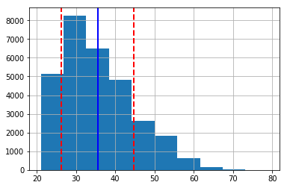
Age Histogram

Slide 13
Statistically Significant?
An independent samples T-Test was used to check if the findings were statistically relevant as proven by a p-value lower than 0.5.
This shows that the mid-age group is less likely to default than early age group.

Slide 14
Old Age v. Senior Age:
OLD AGE
# of Customers: 6,005
Default Percentage: 23.31%
Sample Default: 28.4%
SENIOR AGE
# of Customers: 2,269
Default Percentage: 25.43%
Sample Default: 28.4%

Slide 15
Statistically Significant?
An independent samples T-Test was used to check if the findings were statistically relevant as proven by a p-value lower than 0.5.
This shows that the old age group is less likely to default than senior age group.

Slide 16
Default rates ranging from highest to lowest:
Senior Age Group: 25.43% Old Age Group: 23.37% Early Age Group: 22.43% Mid Age Group: 20.04%

Slide 17
Comparing lowest def rate (mid age) vs. highest (senior) - statistically relevant?
An independent samples T-Test was used to check if the findings were statistically relevant as proven by a p-value lower than 0.5.

Slide 18
Default rate based on education
The dataset has four different education levels:
1 = Graduate Degree
2 = University
3 = High School
4 = Other
Other is not defined so, I am excluding them from the analysis.

Slide 19
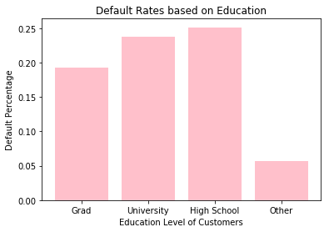
From initial results, it appears default rate goes down as education level goes up.

Slide 20
Statistically relevant?
An independent samples T-Test was used to check if the findings were statistically relevant as proven by a p-value lower than 0.5.
This shows that as education level goes up - default rate goes down.

Slide 21
Default rate based on relationship status.
The dataset has 3 relationship statuses:
1 = Married
2 = Single
3 = Other
I am excluding other from the analysis here as it is not defined.

Slide 22
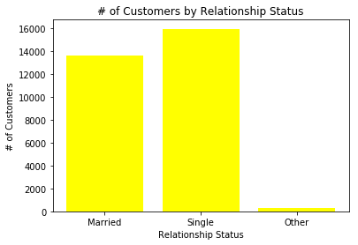
Married vs Single Customers by Count

Slide 23
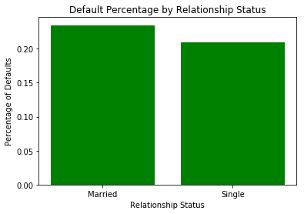
Default percentage by relationship status

Slide 24
Statistically relevant?
An independent samples T-Test was used to check if the findings were statistically relevant as proven by a p-value lower than 0.5.
This shows that single customers are less likely default than married customers.

Slide 25
Is there a correlation between limit balances v. default rates?
To answer this, I tried to see if there was a correlation between default rates found by age groups above vs limit balances.
Limit Balances By Age Group:
Early Age: 167,484
Mid Age: 192,272
Old Age: 179,680
Senior: 164,416
As we can see, mid-age group has the highest limit balance and the lowest default rate from previous findings.

Slide 26
Higher limit balance correlates to lower default rate in early v. mid-age group. Statistically relevant?
An independent samples T-Test was used to check if the findings were statistically relevant as proven by a p-value lower than 0.5.
This shows that mid age customers with higher balances are less likely default than early age customers with lower balances.

Slide 27
Same thing was found for old age v. senior group via a T-Test.
For further analysis, I compared the highest default rate (seniors) vs lowest default rate (mid-age) and found it statistically relevant as well via a T-Test.

Slide 28
Does limit balance correlate w/ default rates?
I wanted to look at limit balances only without looking at age. To do this, I divided the limit balances by 100,000 to create ranges from 0 to 10.
0 being the lowest and 10 being the highest limit balance.
I then plotted that to a scatter plot.

Slide 29
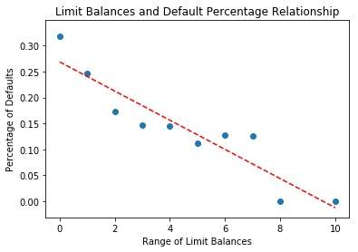
Correlation between Range of Limits v. Default Percentage
There is a clear trend between default percentage decreasing as limit balances increase as shown by the trendline.

Slide 30
Statistically relevant?
To avoid drastic results, I omitted point 8 with a 0% of default and 1 which is a really high default percentage / an outlier.
By doing a two sample T-Test, I found that this was statistically relevant as p value is lower than 0.5.

Slide 31
Can bill amount predict default rate?
To do this, I created a range of sum of bill amounts.
To do so, I added all the bills (there are 6 of them) and then I created a range of bill amount by dividing rounding them to a whole number and dividing them by 300,000.
This led to total of 18 ranges of bills and I grouped by the range of bills
. I then graphed the relationship between range of bills and limit balances.
I then found that limit balances are positively correlated to bill amount i.e. the higher the limit balance is - the more the bill amount is.

Slide 32
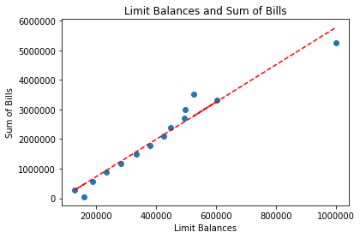
Correlation between bills and limit balances

Slide 33
Bills vs Default Percentage - as bills go up, does default percentage go up?
To do this, I created a graph with a trendline. I only included group 0 - 10 as after 10 the default rate goes to zero.
I found that there was a positive correlation between default rate and sum of bills. As bill amount goes up, default percentage goes up as well.

Slide 34
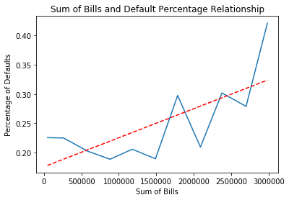
Sum of Bills and Default Percentage
The trend line shows that default percentage generally goes up when bills increase. There are only two points that are out of the trendline.

Slide 35
Further Analysis
I think for further analysis, it would be interesting to look at a few other factors such as combination of various demographic factors together to see if that would impact default rates. Some questions I would pose in the future are: How does combination of one or more social factor impact default rate? A female that is married / has a graduate degree vs. a male that is single and has a university degree? I would also like to evaluate the data in terms of payment delays. I think it would be interesting to see how much delayed payments impact default percentage. Does it get worse as the delays get further into the year?

